Slide 1


Analyzing Weather Data with Python
Greg Filla, Associate Offering Manager
Data Science Experience

Slide 2
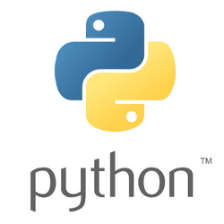
About me
Working at IBM for ~2 years - Product Management, Analytics
Started career as analyst…started coding
I Like Python - Pandas, Sklearn, Jupyter, Flask, PySpark, etc.
Twitter: @gdfilla
Github: https://github.com/gfilla

Slide 3



Introducing the Data Science Experience
Learn
Create
Collaborate
Built-in learning to get started or go the distance with advanced tutorials
The best of open source and IBM value-add to create state-of-the-art data products
Community and social features that provide meaningful collaboration
http://datascience.ibm.com
Notes:
Now let’s dig into the IBM Data Science Experience (DSX). DSX is a single place to Learn, Create, and Collaborate – the 3 pillars of a successful data science organization. With DSX we are making it easier for data scientists and data science teams to learn new skills and technologies from the fast moving data science profession.
Users can join the 400,000+ registered users on Big Data University to take courses and administer custom curriculum on Data Science. DSX also provides freely available datasets, code samples, tutorials and articles from the data science community, thereby making it easier for data scientists to learn in-context.
We also know that a data science team isn’t going to standardize on a single technology or tool – data scientists need an open and integrated platform that brings all of their tools in one place. DSX brings together the best of open source such as RStudio, Spark, and Python in an integrated environment along with IBM value-adds, such as a managed Spark service and data shaping capabilities all in a secure and governed way.
Users can collaborate in DSX with ease -- you can manage project assets and user collaboration through built-in social features for sharing, forking, and reusing assets. These built-in collaboration features can really help boost team productivity and managing projects across their lifecycle.

Slide 4
Core Attributes of the Data Science Experience
IBM Data Science Experience
Community
Open Source
IBM Added Value
Find tutorials and datasets
Connect with Data Scientists
Ask questions
Read articles and papers
Fork and share projects
Code in Scala/Python/R
Jupyter Notebooks
RStudio IDE and Shiny apps
Apache Spark
Your favorite libraries
Data Shaping/Pipeline UI *
Auto-data preparation and modeling*
Advanced Visualizations*
Model management and deployment*
Documented Model APIs*
Spark as a Service
Powered by Watson Data Platform
* DSX product roadmap items
Notes:
The new offering IBM Data Scientist Experience brings together everything that a Data Scientist needs today to be more successful. It is based on three things:
Community: A Data Scientist needs to be updated with the latest news from the Data Science Community. There are plenty of new Open Source packages, libraries, techniques and tutorials available every day. A good Data Scientist follows the most important sources and shares their opinion and experiments with the community. We are bringing this into the UI of the DSX.
Open Source: Today there are companies that rely on open source for data science. Open source has become so mature that is directly competing with commercial offerings. We provide the best of open source within DSX, such as Spark, RStudio, Jupyter, and more.
Value Add: We improve open source by adding some capabilities from IBM. Data Shaping for example takes 80% of the Data Scientist time. We are providing tools with visual GUI to help users better perform this task. You are also able to execute Spark jobs on our managed Spark Service in Bluemix from within the DSX.

Slide 5
Data Science Methodology Diagram
Business Understanding
Analytic Approach
Data Requirements
Feedback
Data Collection
Deployment
Data Understanding
Evaluation
Modeling
Data Preparation
Notes:
So this is the data science methodology, and it’s borrowed from the CRISP-DM methodology from data mining.
It is a flowchart that begins from … Business Understanding…
---
Looking at this diagram, we immediately spot two outstanding features of our methodology:
First, it is highly iterative, meaning that we typically go back and forth between stages throughout the problem-solving process.
Second, there is no endpoint, meaning that the process remains in play as long the problem is relevant.
Today, we will try going through the methodology as we tackle a data science problem using K-Means clustering.

Slide 6
Data Science Methodology Diagram
Business Understanding
Analytic Approach
Data Requirements
Feedback
Data Collection
Deployment
Our focus today
Data Understanding
Evaluation
Modeling
Data Preparation
Notes:
So this is the data science methodology, and it’s borrowed from the CRISP-DM methodology from data mining.
It is a flowchart that begins from … Business Understanding…
---
Looking at this diagram, we immediately spot two outstanding features of our methodology:
First, it is highly iterative, meaning that we typically go back and forth between stages throughout the problem-solving process.
Second, there is no endpoint, meaning that the process remains in play as long the problem is relevant.
Today, we will try going through the methodology as we tackle a data science problem using K-Means clustering.

Slide 7
Machine Learning
Supervised vs. Unsupervised

Slide 8
Toolbelt of the Data Scientist
Linear regression (S)
Logistic regression (S)
Decision Trees (S)
Clustering (U)
Principal component analysis (U)
Text analysis (S/U)
SVM/SVR (S)
Neural networks (S/U)
Recommender Systems (S)
S == Supervised Learning Technique
U == Unsupersved Learning Technique
S/U == Can be combination of both

Slide 9
Which weather stations are similar to each other based on weather observations?
Group similar stations together
into k number of clusters.

Slide 10
Which weather stations are similar to each other based on weather observations?
k = 3
Group similar stations together
into k number of clusters.
Notes:
But how ? Cuisines are text-based. So does k-means use text as well?

Slide 11
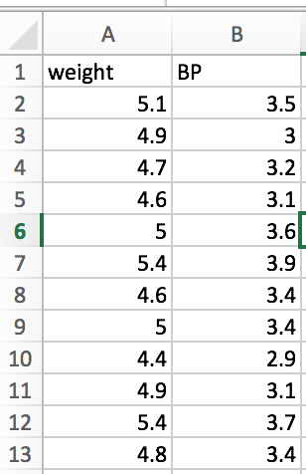
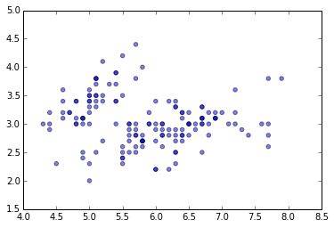
K-means Clustering
1) Load your data
Blood Pressure
BMI

Slide 12
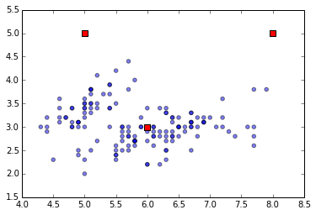
K-means Clustering
2) Initialize k=3 centroids randomly
[[8., 5.],
[5., 5.],
[6., 3.]]

Slide 13
K-means Clustering
3) Calculate distance of all points from centroids

Slide 14
K-means Clustering
4) Find the closest center to each data point

Slide 15
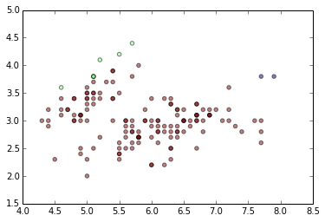
K-means Clustering
5) Assign each point to the closest centroid

Slide 16
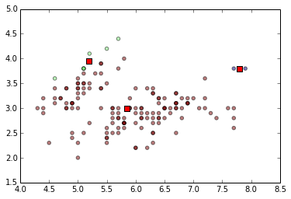
K-means Clustering
6) Compute the new centroids for each cluster.

Slide 17
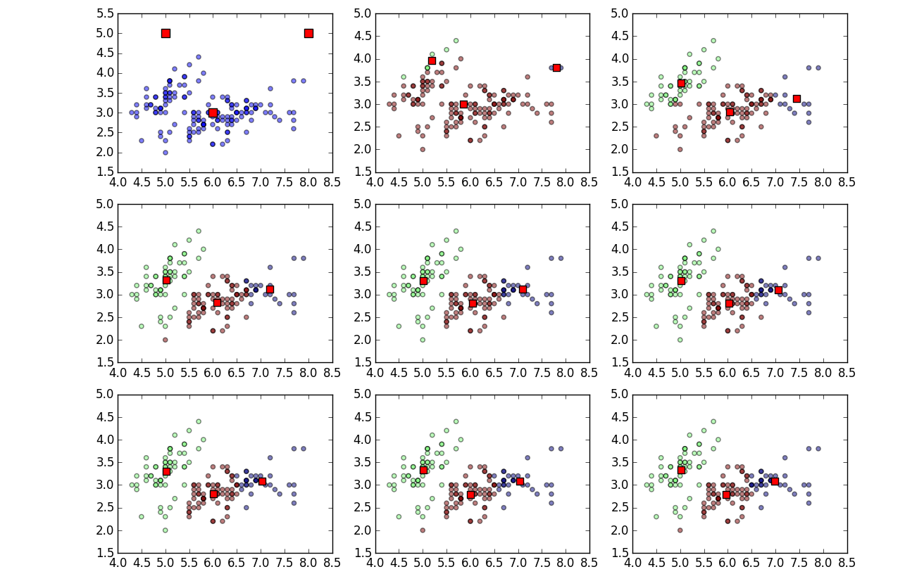
7) Repeat until there are no more changes

Slide 18
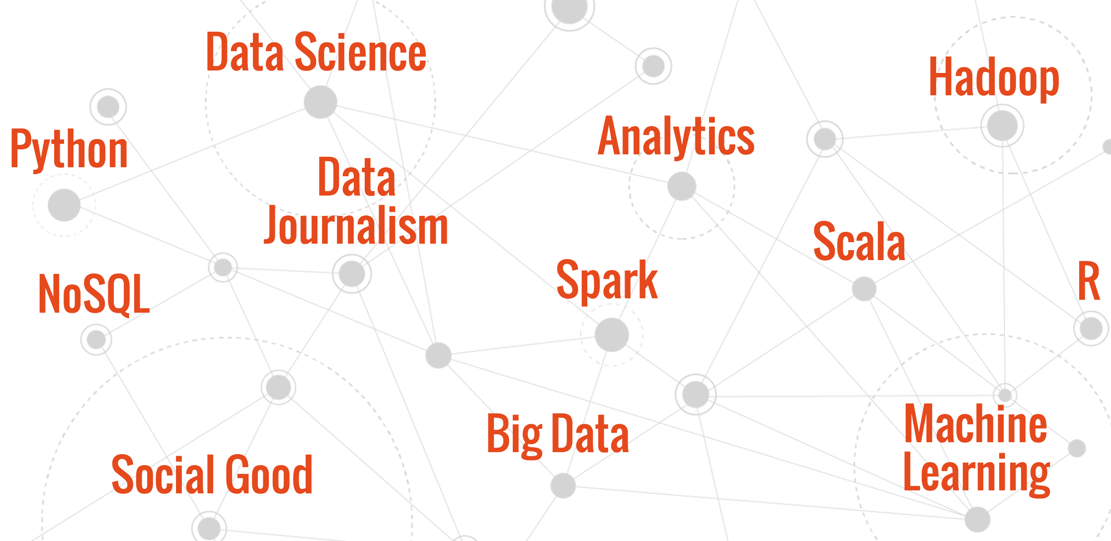
Free Online Courses
www.BigDataUniversity.com

Slide 19
Let’s jump into DSX to look at come code!

